Slide 1


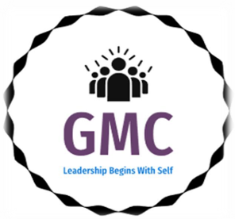

THE GMC –AUNUA CHAPTER

Slide 2

What we do
The GMC program is designed to empower women and young people from underserved communities, helping them become self-sustaining while fostering positive change within their communities. By equipping individuals with essential skills, knowledge, and leadership tools, we aim to create a ripple effect, where beneficiaries share what they’ve learned to uplift others, ultimately improving the overall well-being of the community.

Slide 3
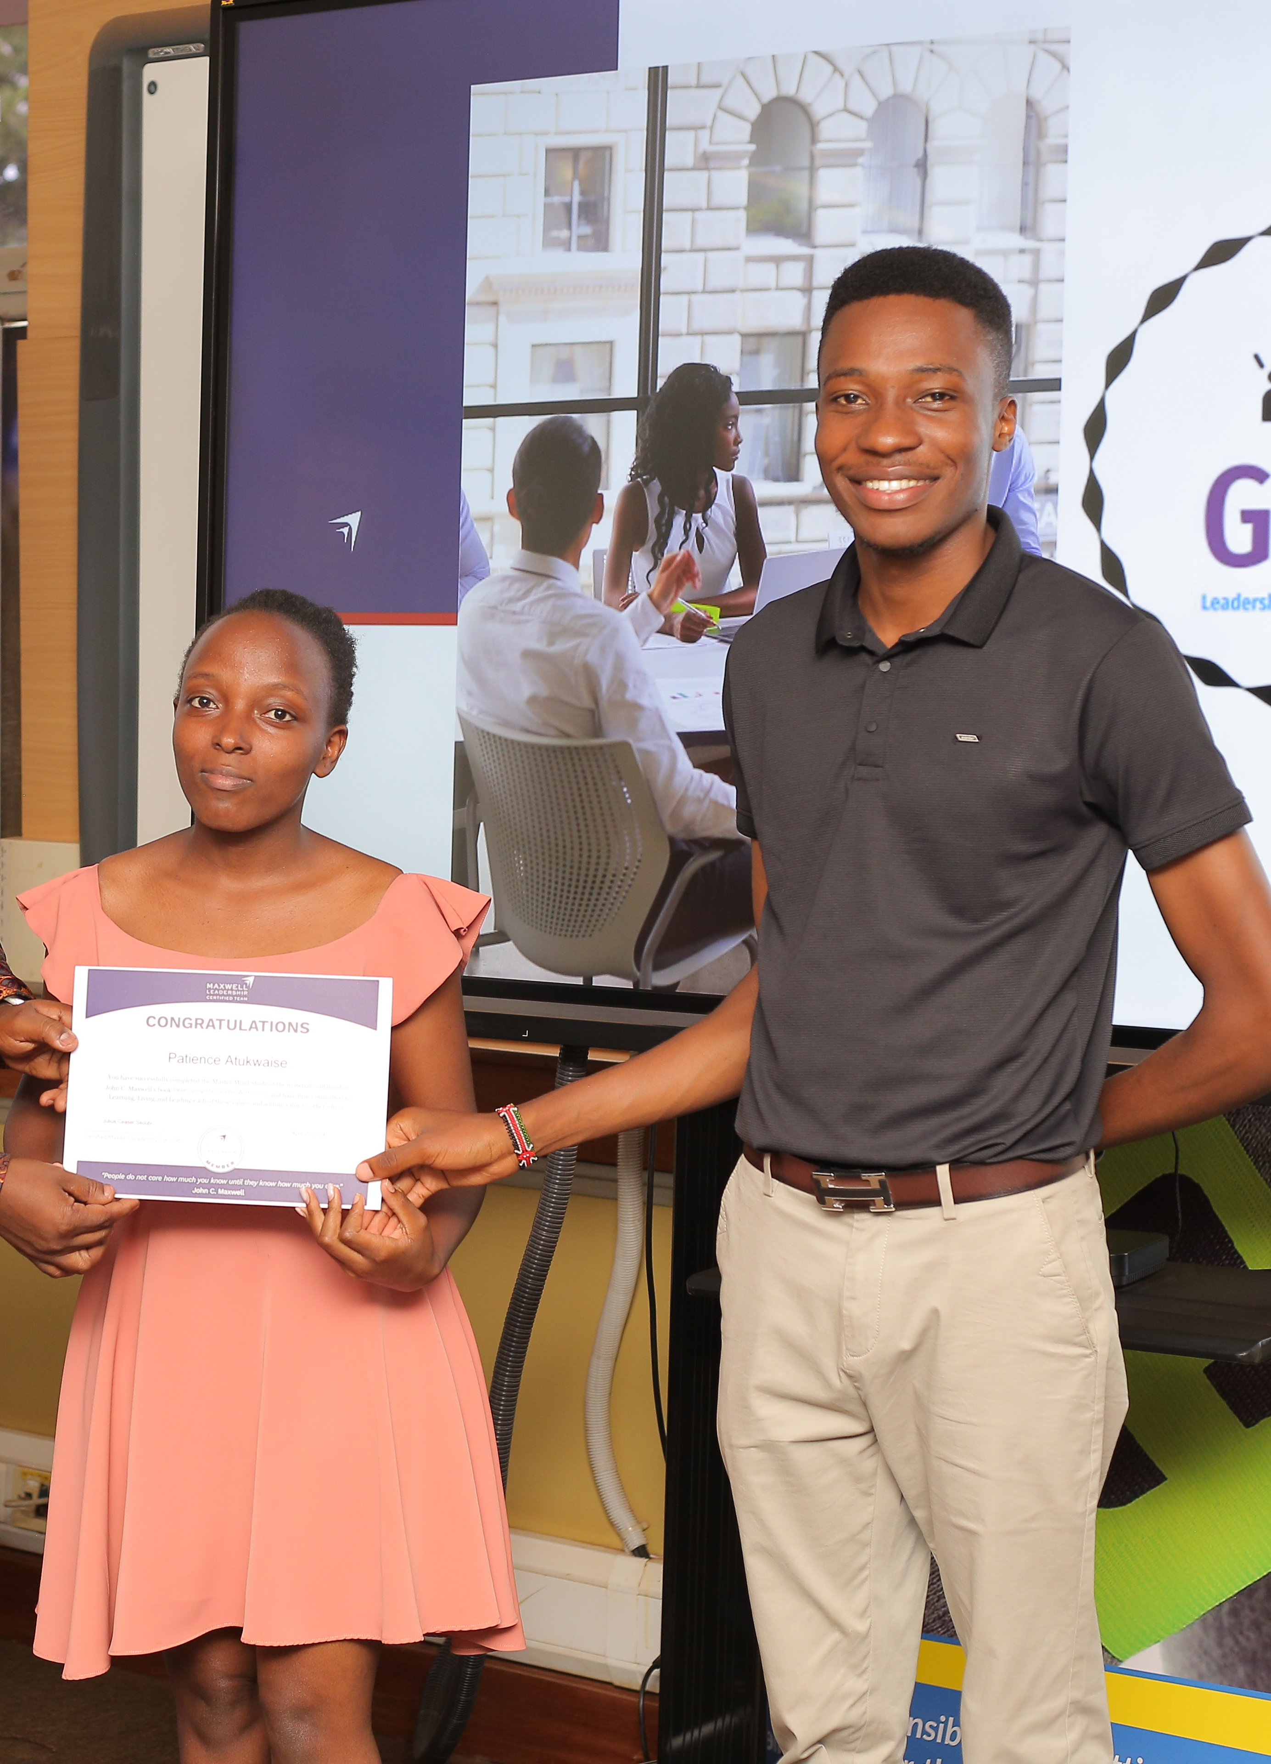
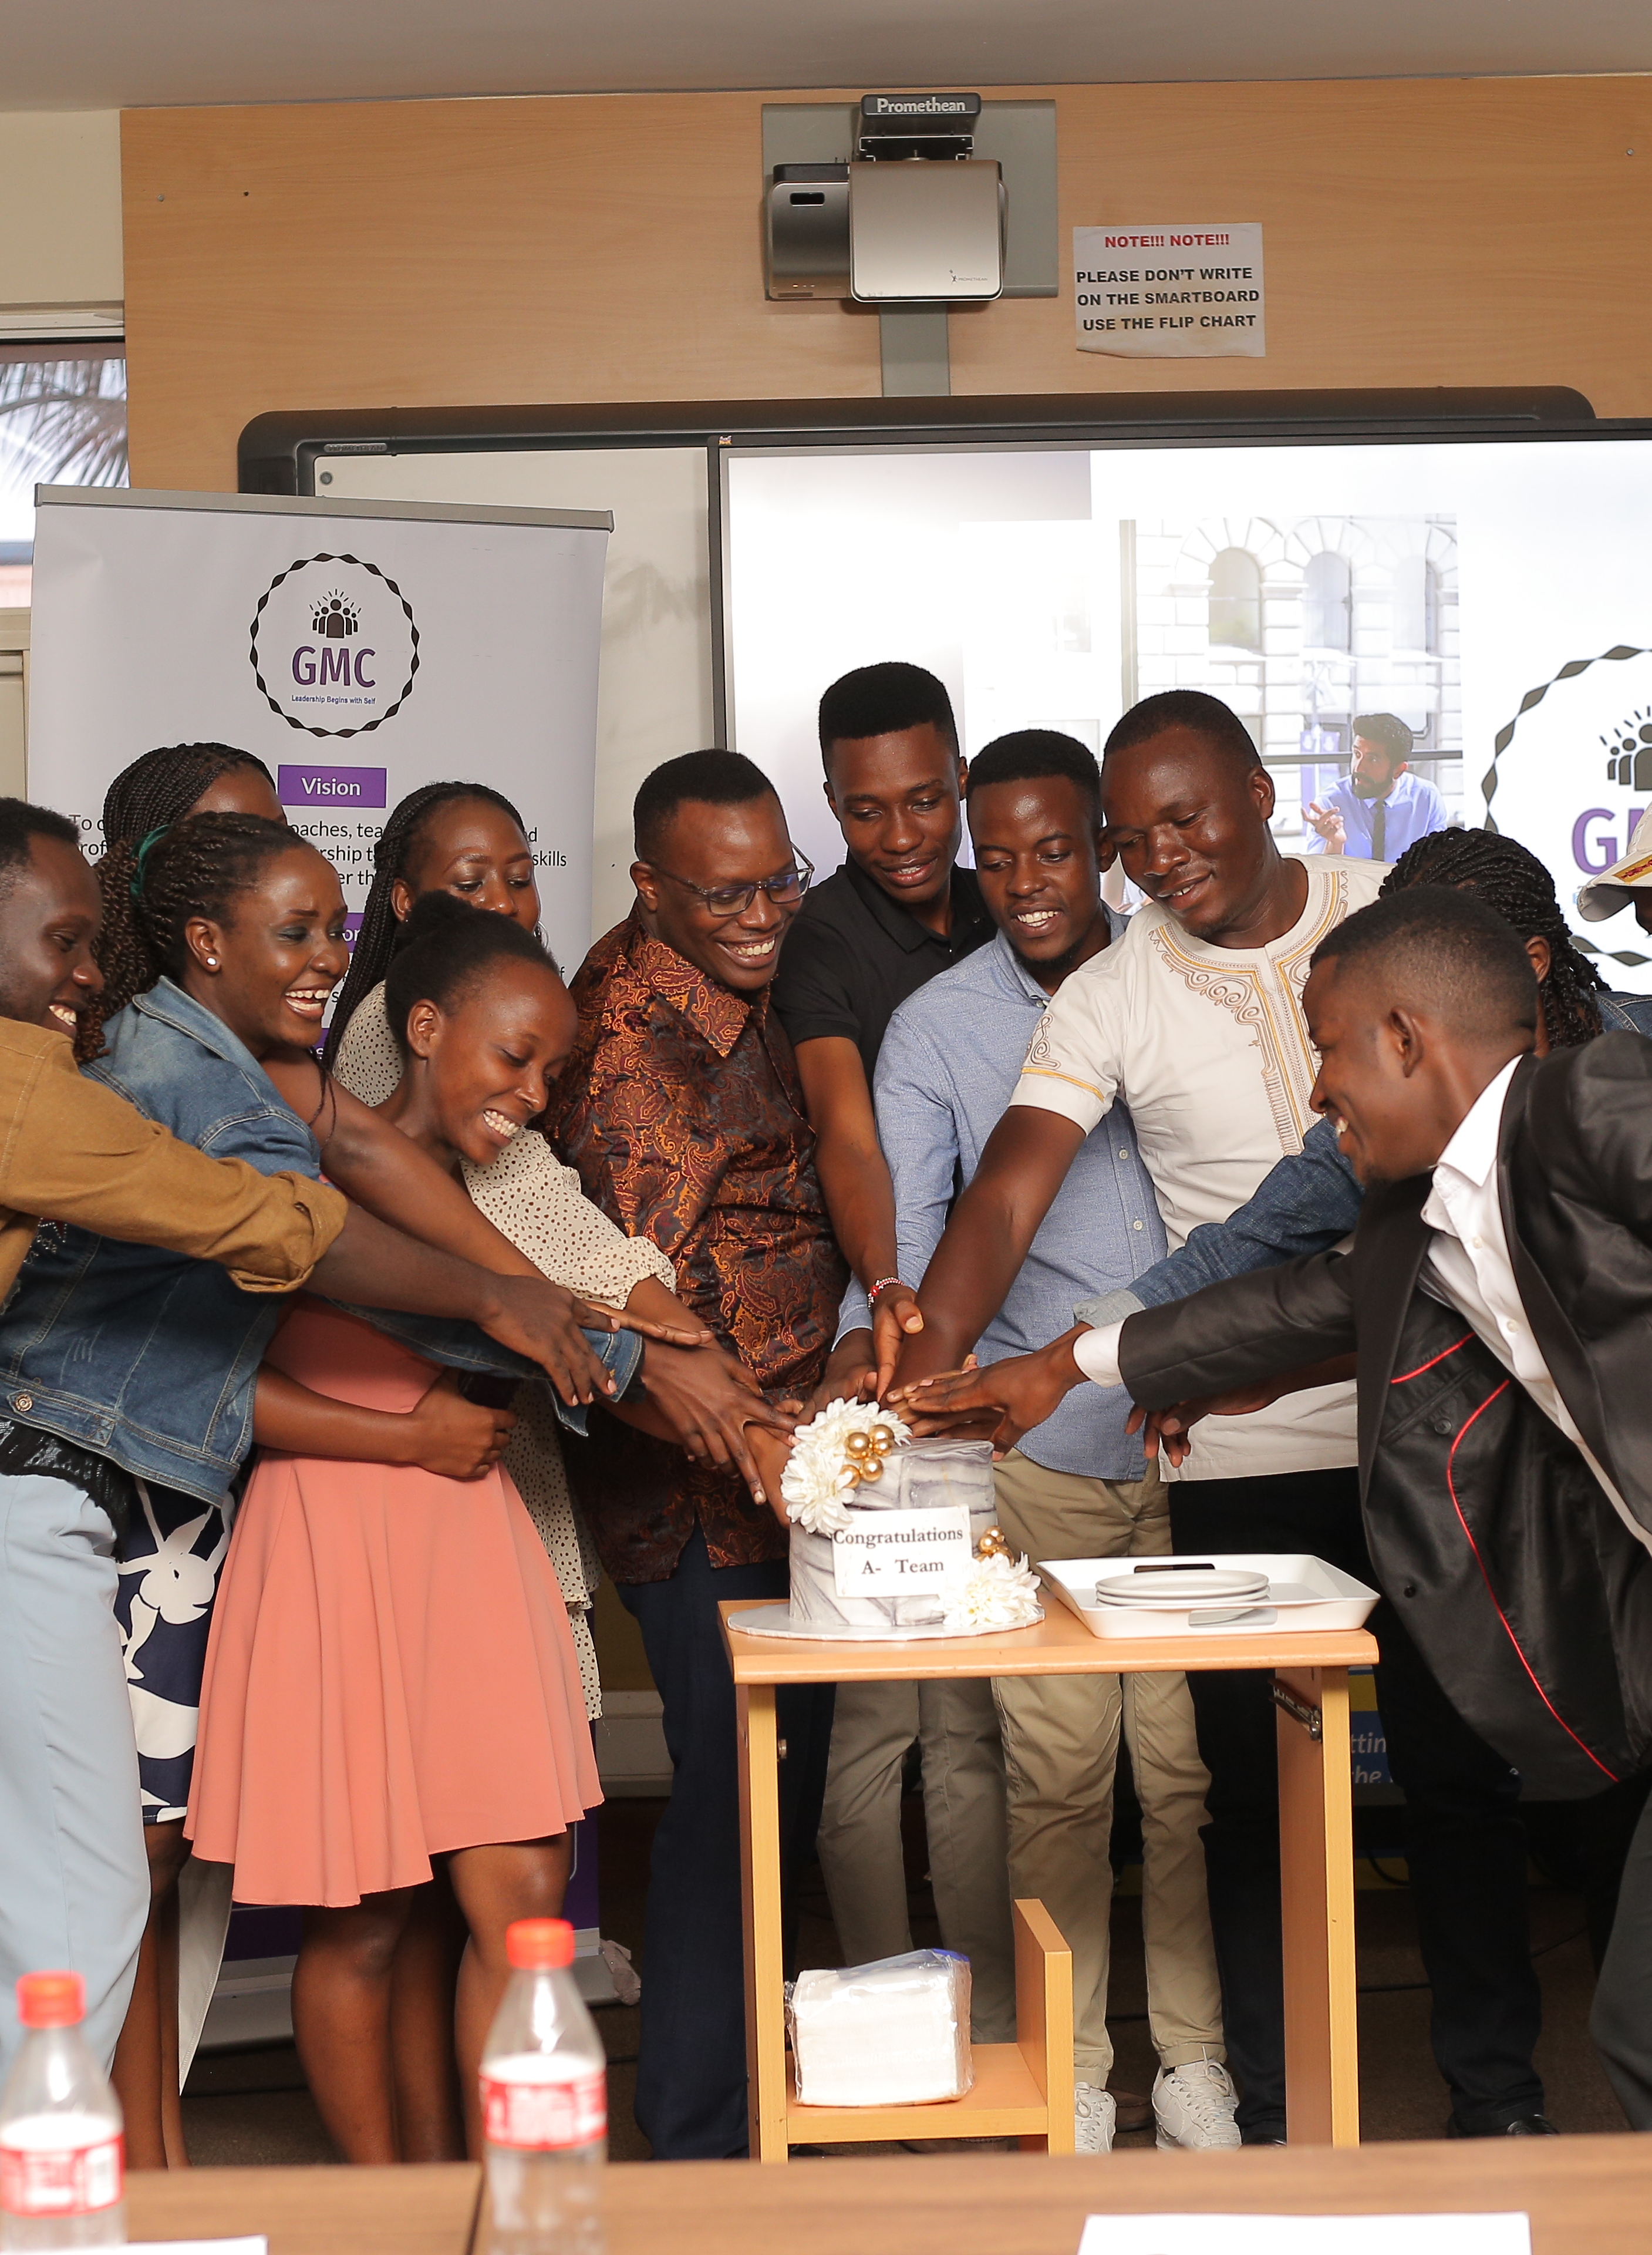
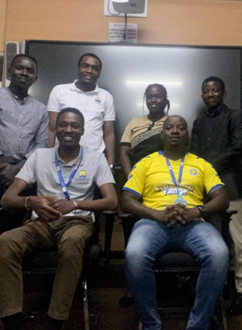
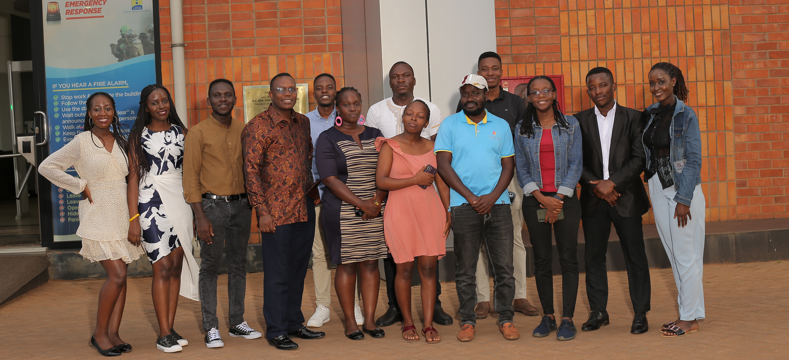
Empowering Individuals Through Education and Mentorship
Our initiative, launched in 2024, began with the first cohort of GMC founders—five committed partners—who underwent a two-month mentorship program focused on leadership and public management. These pioneers played a crucial role in the program’s self-replication, sharing their acquired knowledge with a second cohort of 12 partners. Over two months, these partners participated in hybrid mentorship sessions, which included both virtual and in-person training, preparing them to become change agents in their communities. They graduated in may 2024, fully equipped to drive positive impact.

Slide 4
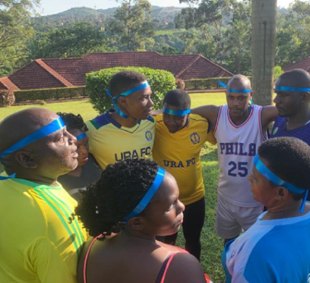
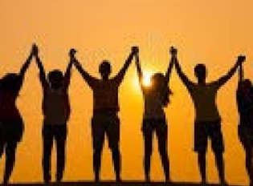

Core Values and Holistic Development
The core values of the program revolve around influence, character, personal growth, problem-solving and creating meaningful change. These values directly contribute to the well-being of individuals and the broader community. We believe that every person, regardless of their background, has valuable ideas that can contribute to both their personal well-being and that of their community. This belief is what fuels our drive for empowerment, sustainability, and social equity.

Slide 5
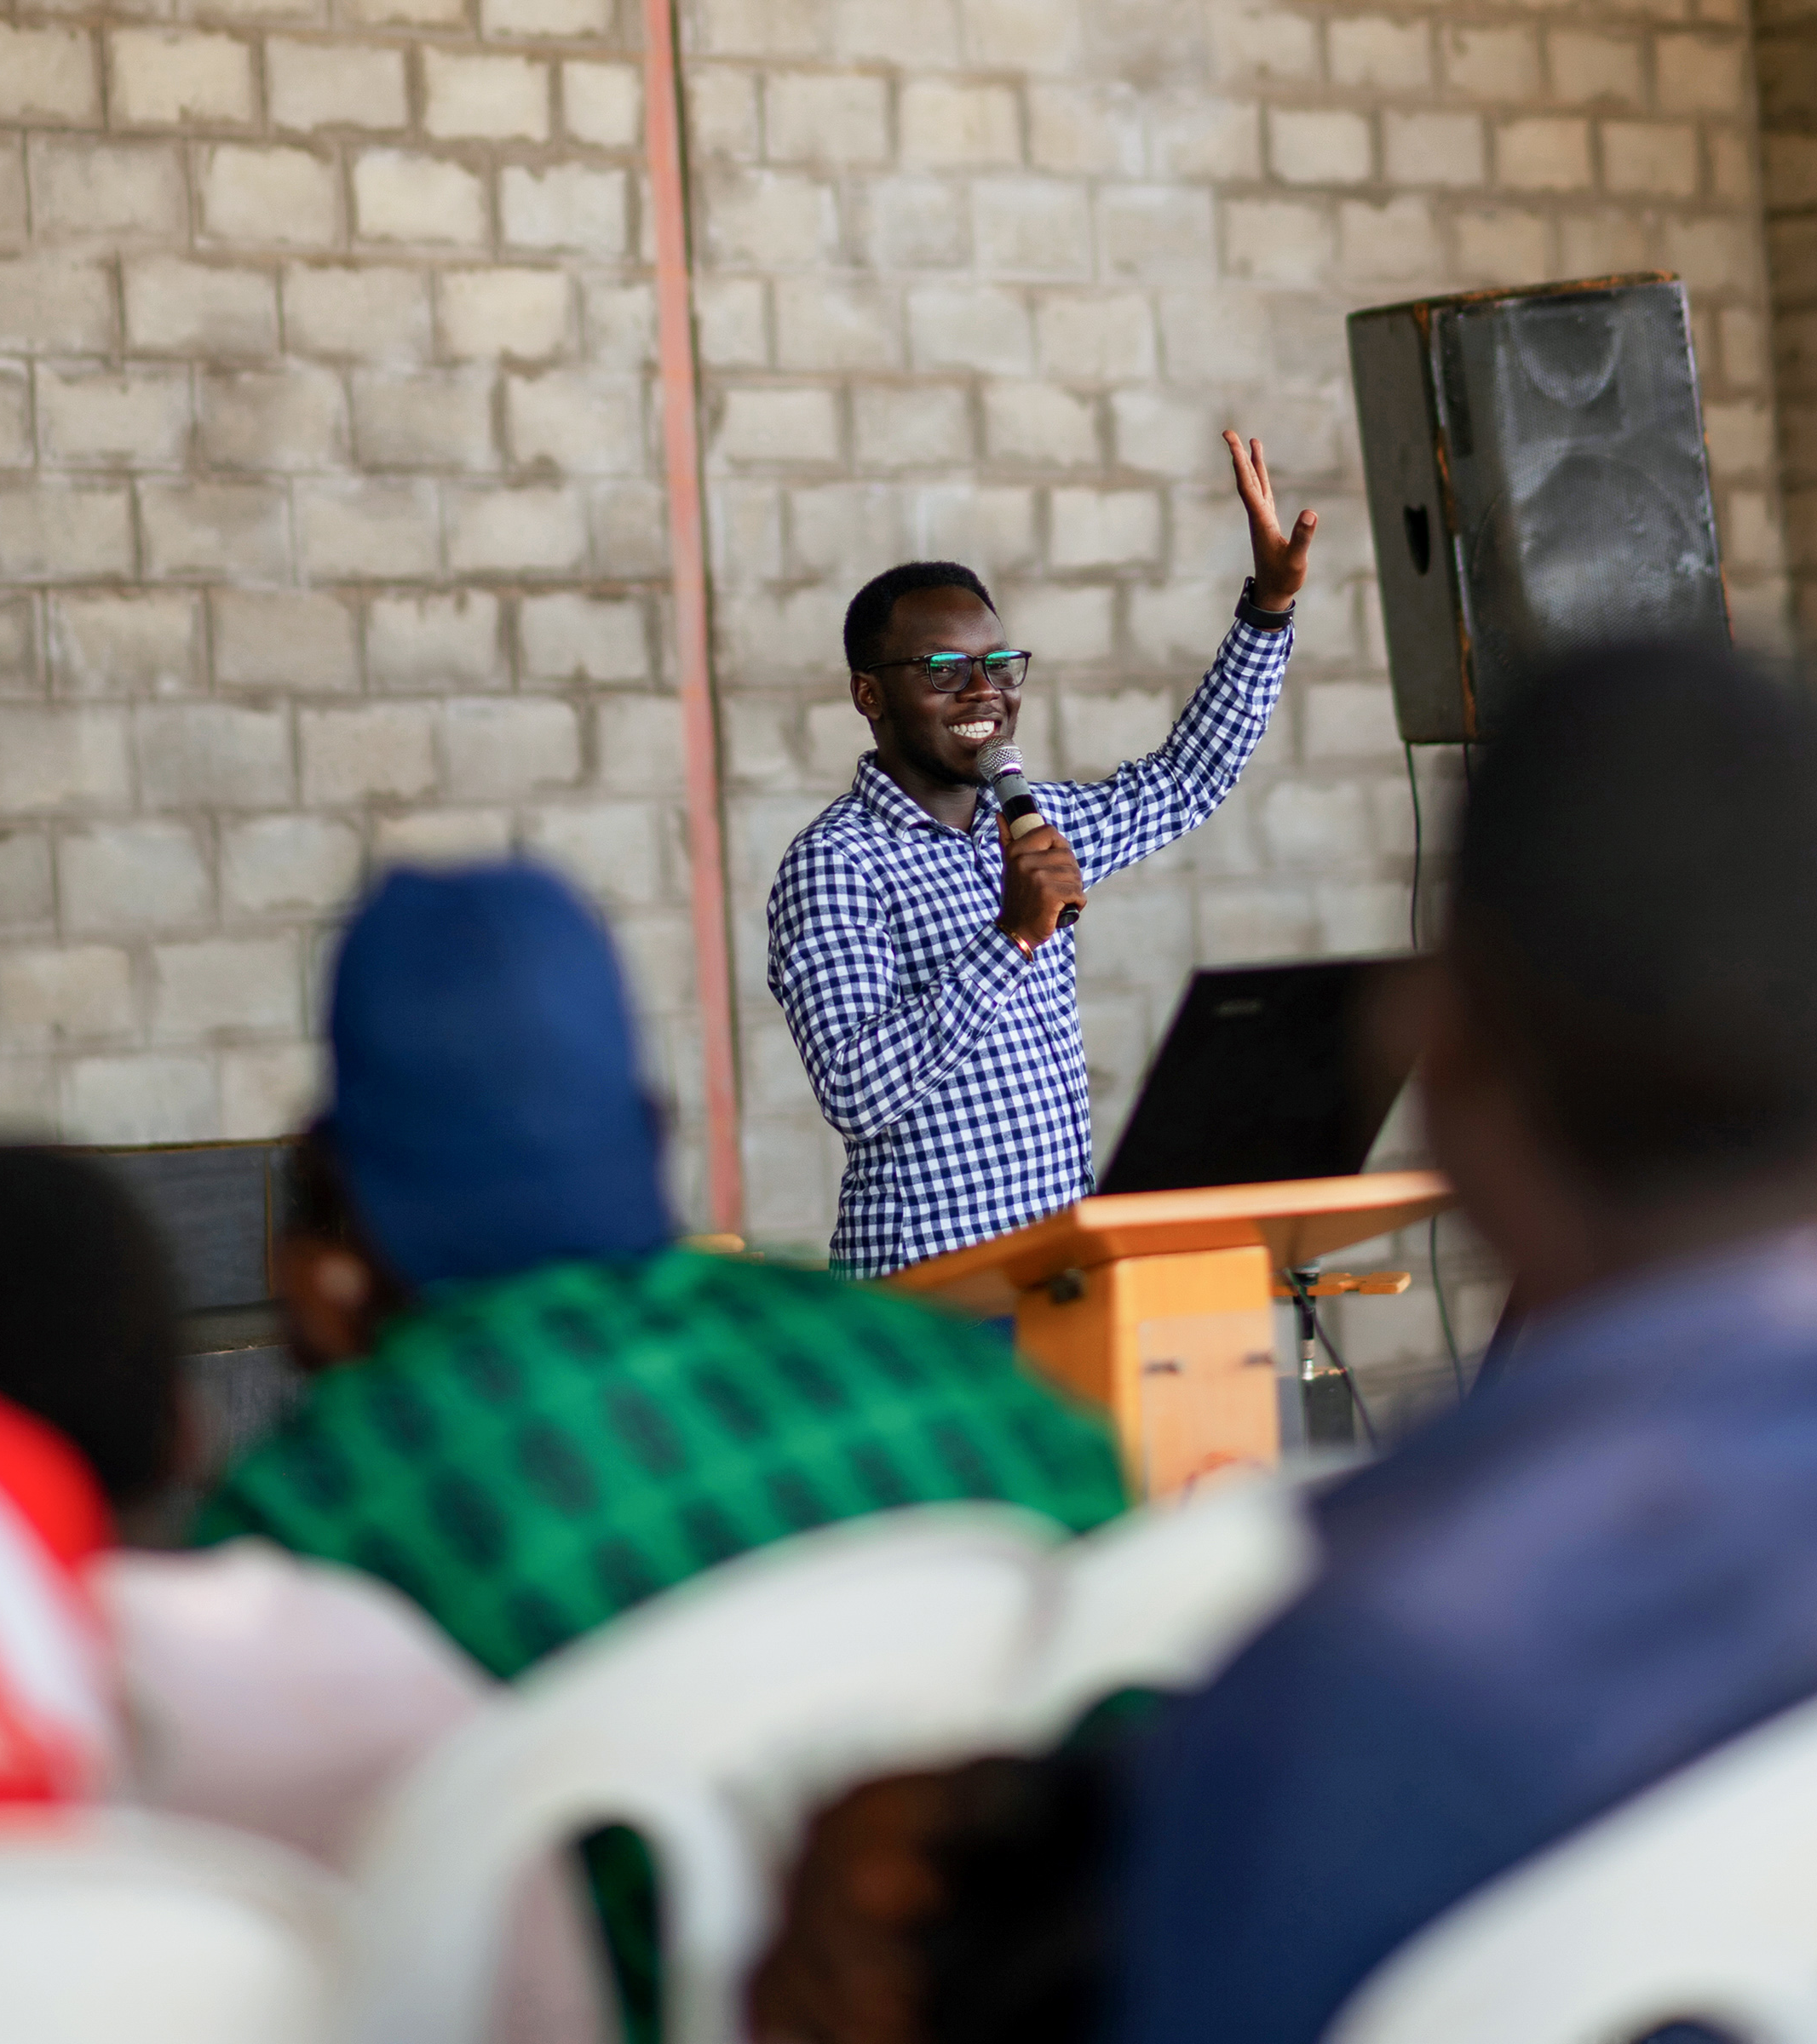
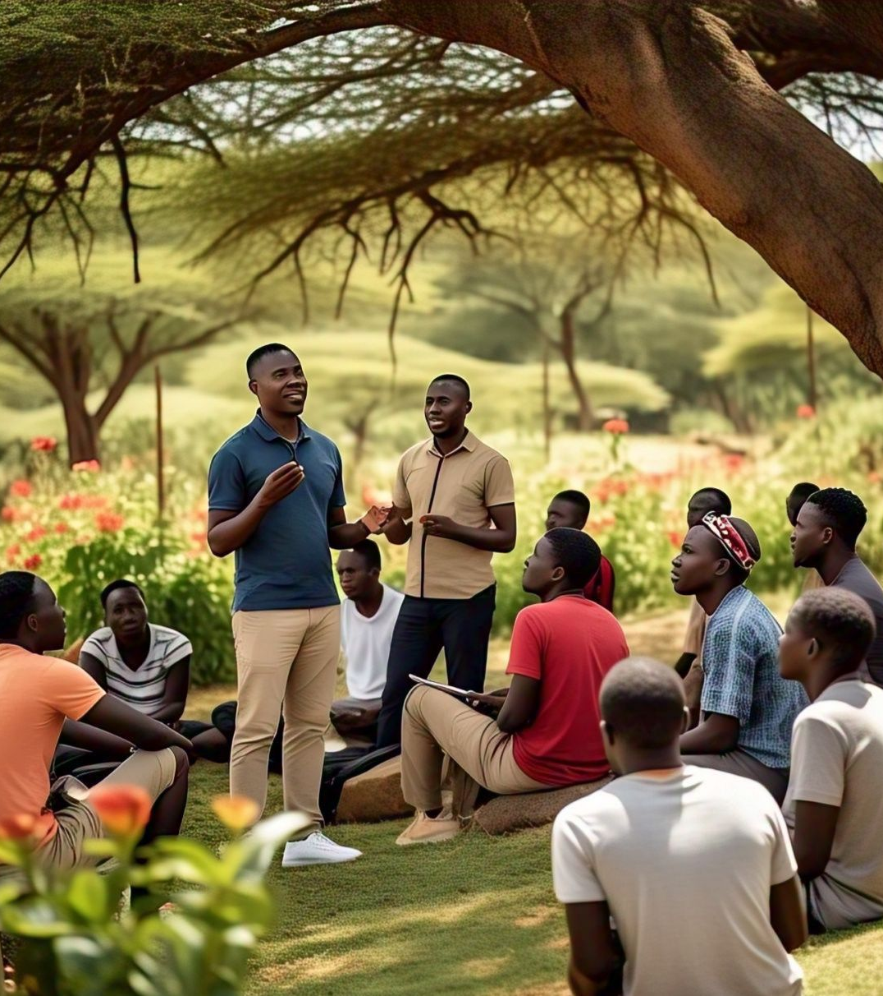
Entrepreneurship and Economic Empowerment
To further broaden the program’s impact, we have expanded our focus to include entrepreneurship and sexual reproductive health, both essential aspects of improving the target groups' quality of life. The entrepreneurship component provides participants with crucial financial literacy skills, including savings, capital funds, income management, return on investment, and market dynamics plus digital entrepreneurship. This equips them to engage in economic activities that can enhance their livelihoods, unlocking new opportunities for financial independence. Additionally, we encourage creative pursuits such as arts and crafts, writing, music composition, singing, acting, production, fashion, make up, agriculture among others which can also serve as possible income streams.

Slide 6
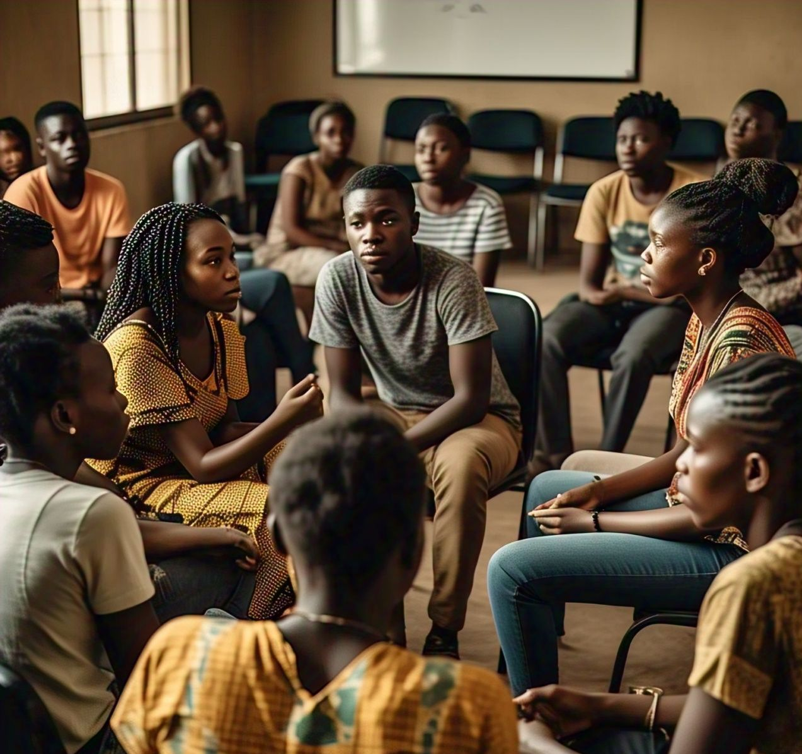
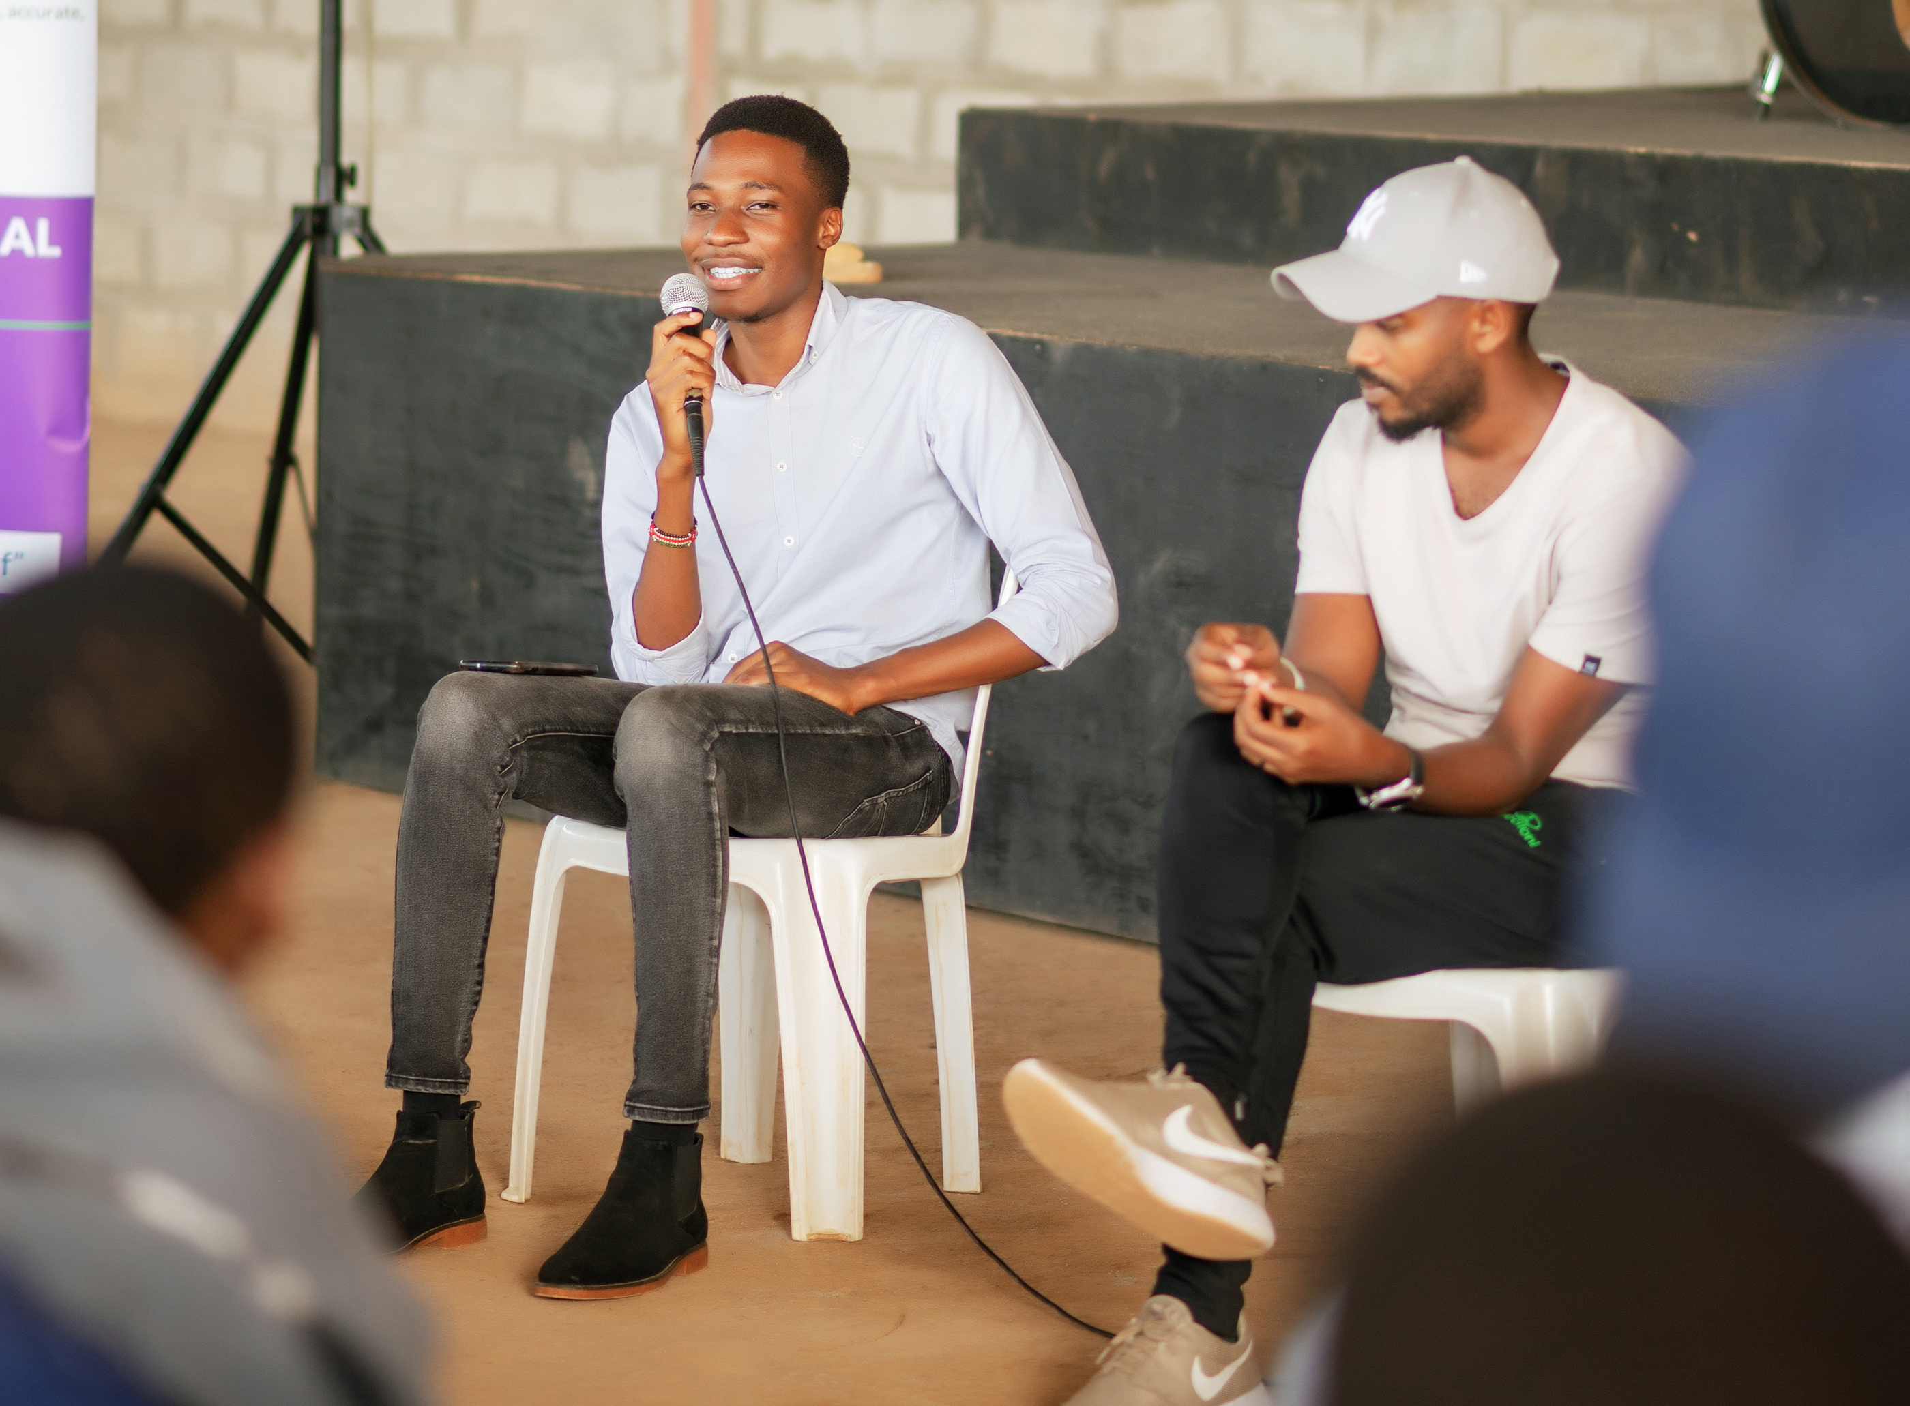
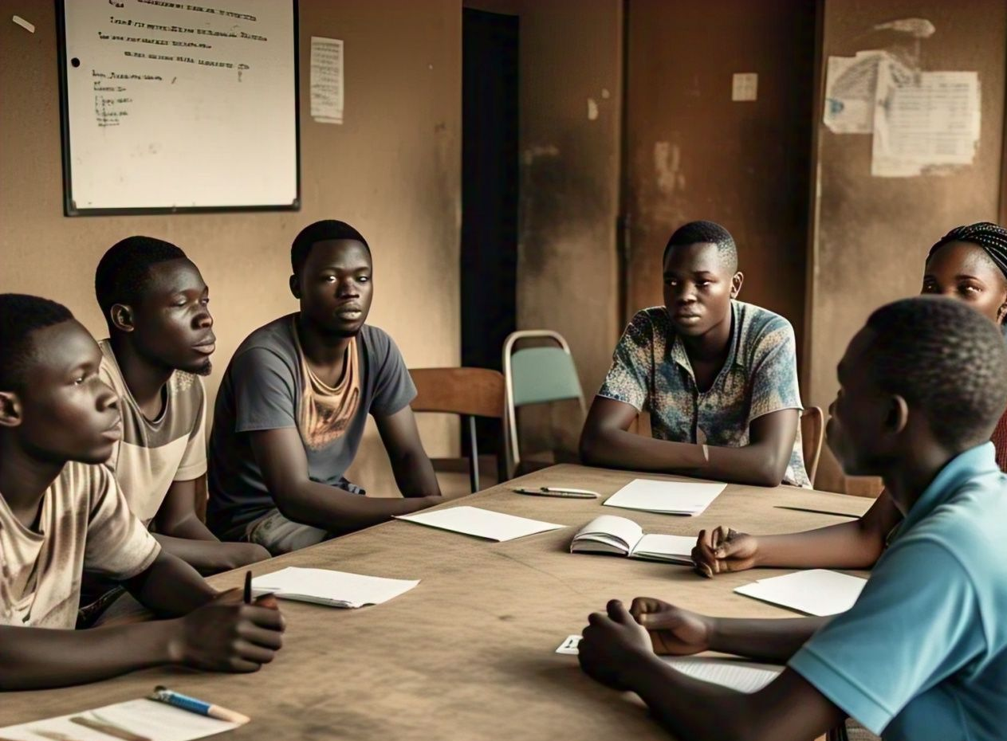
Health Education and Sexual Reproductive Health
Sexual reproductive health education aims to equip young people with knowledge about the changes they experience during their transition to adulthood. It empowers them to make informed decisions, stay safe and protect themselves from sexually transmitted diseases, improving their overall health and well-being.

Slide 7
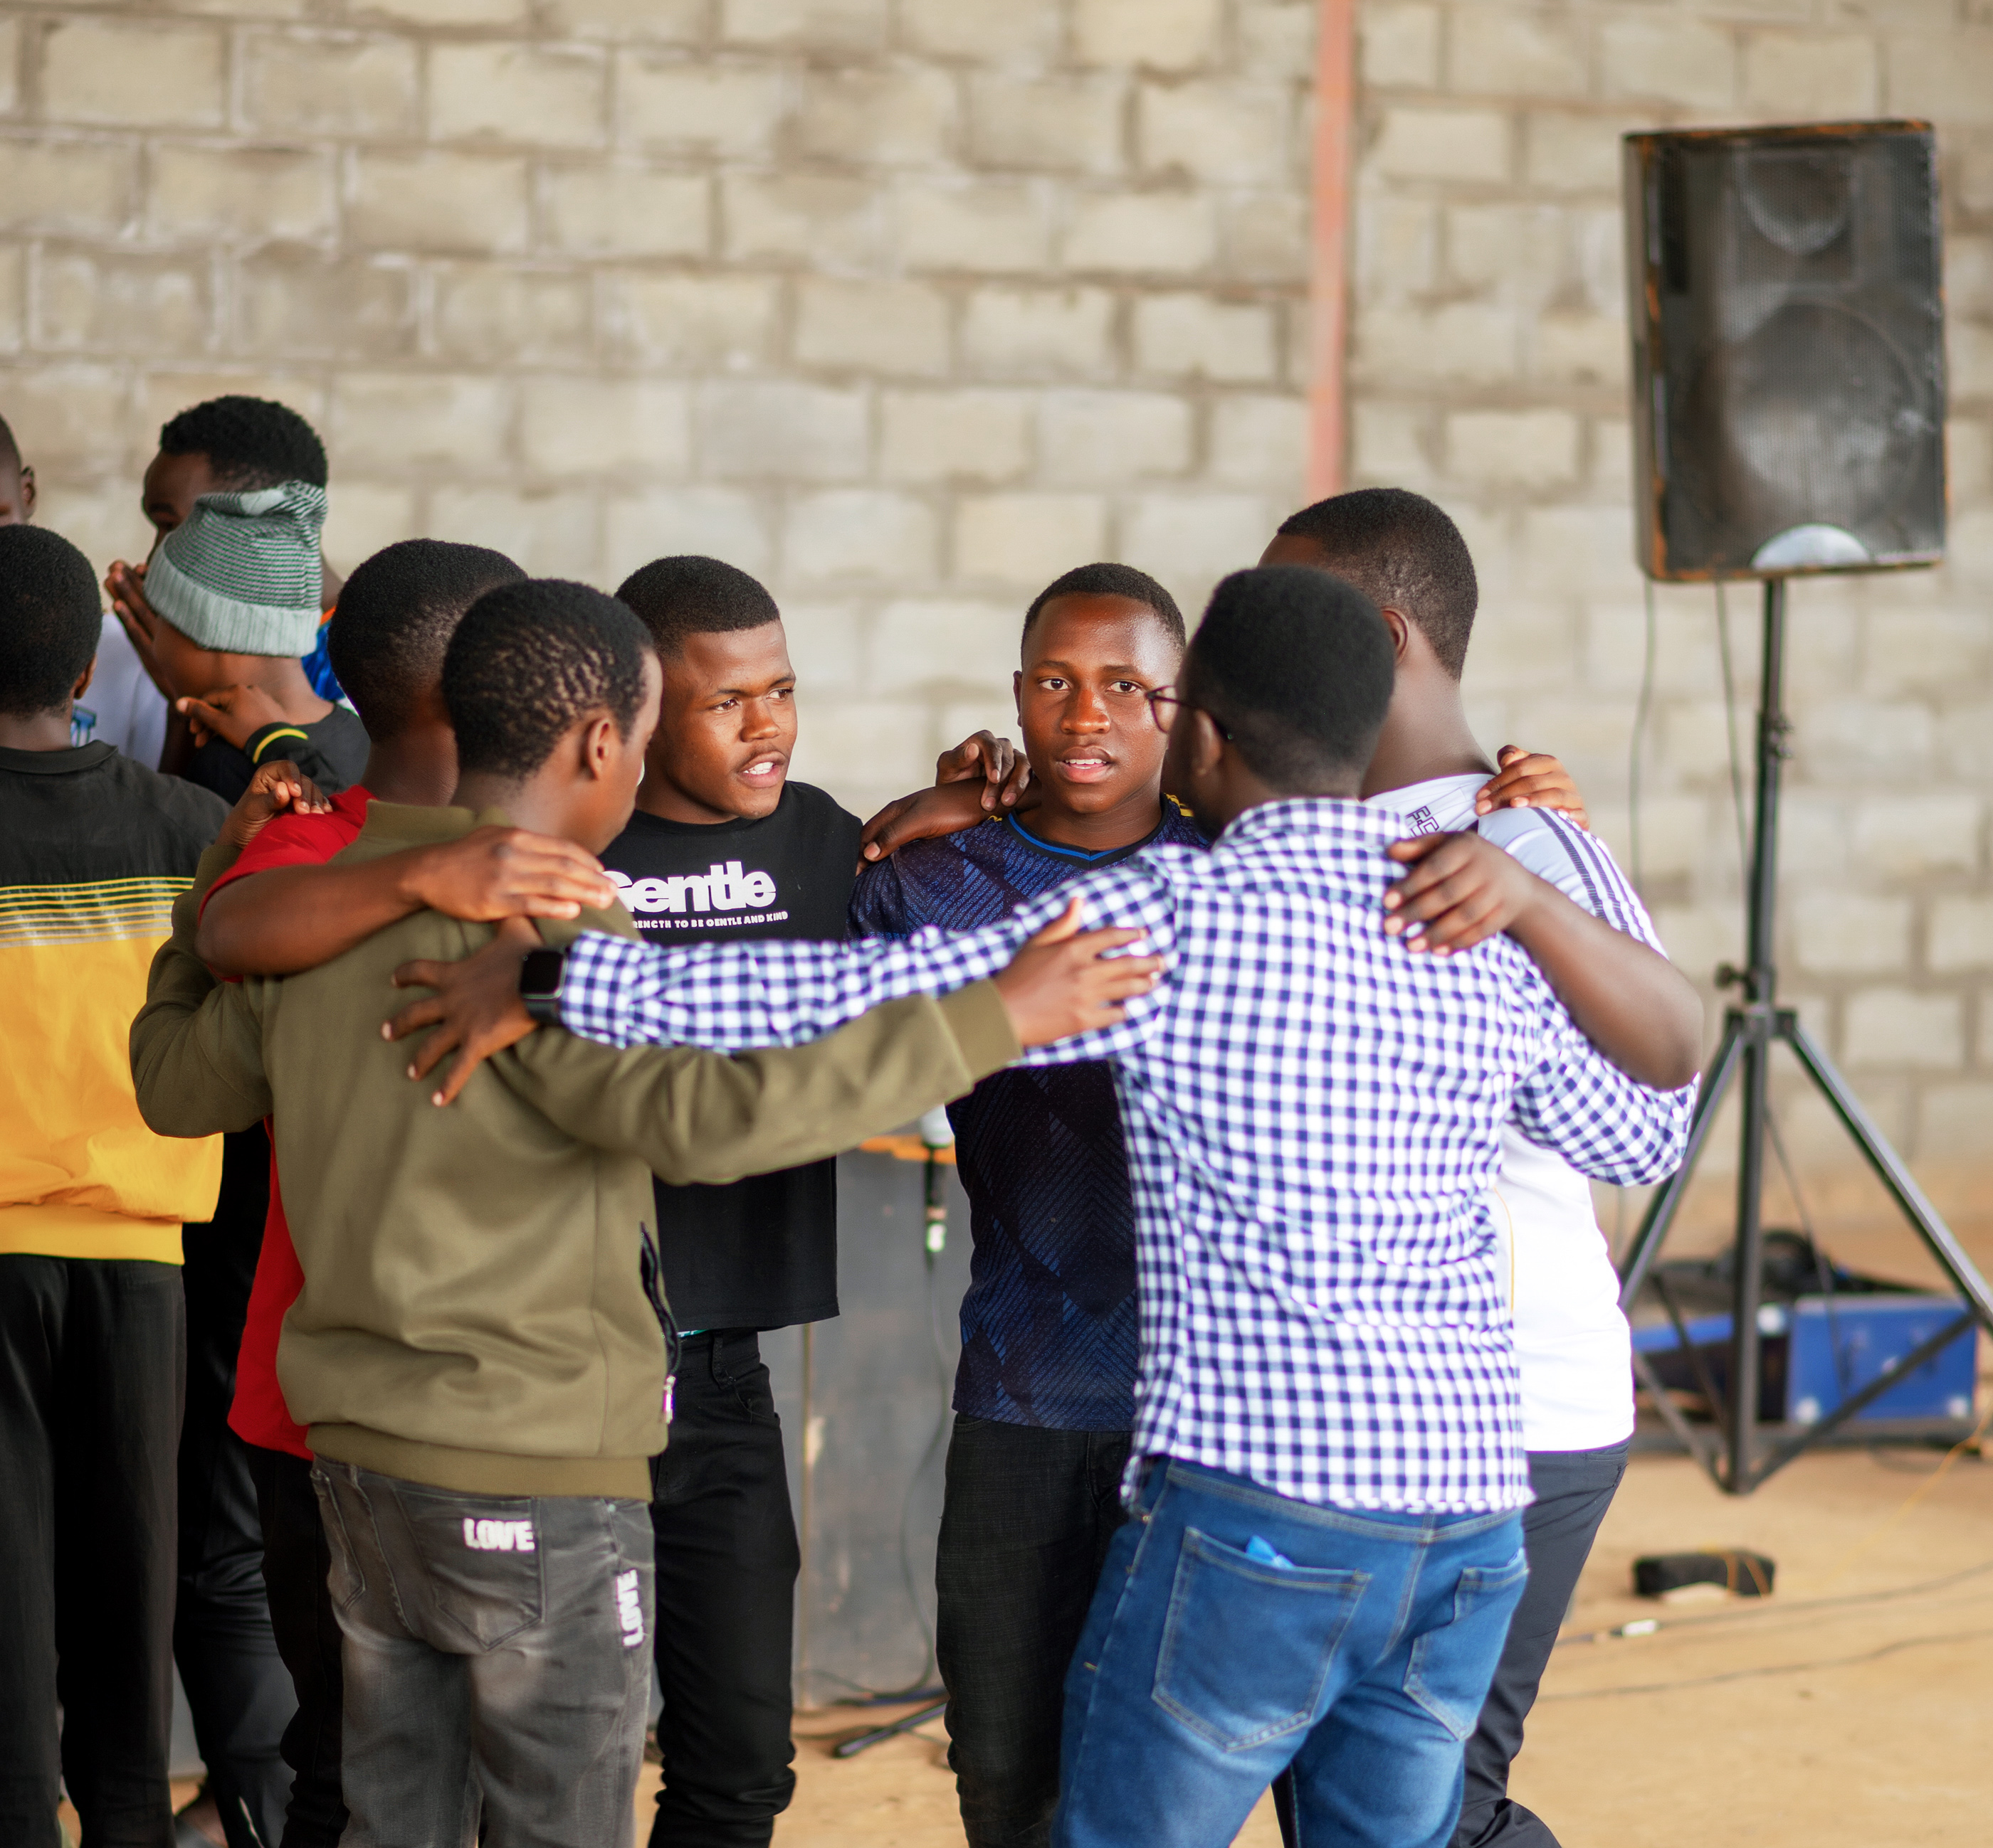
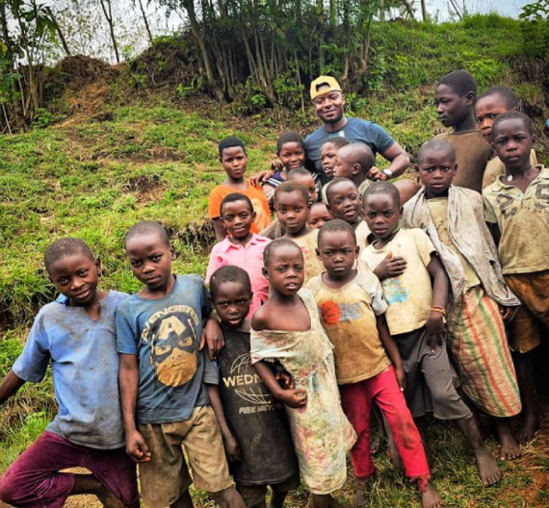
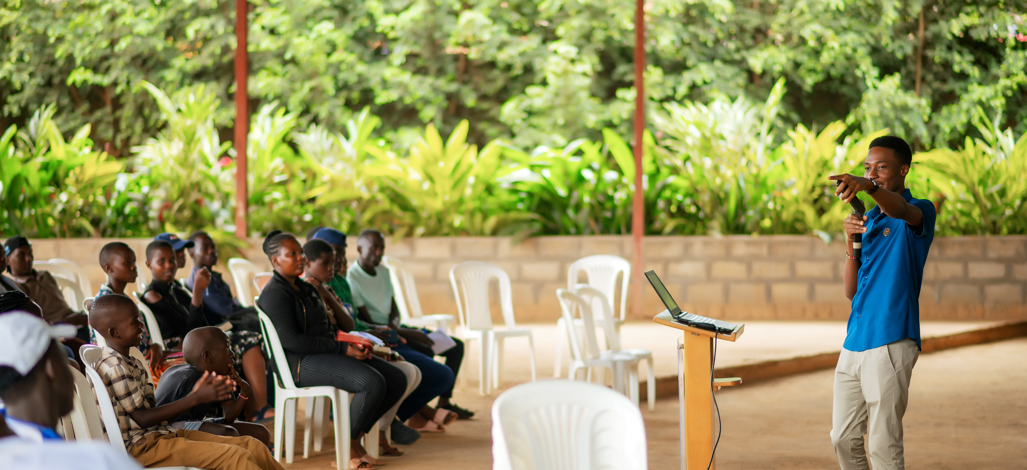
Impact on Children and Youths in Vulnerable Communities
In September 2024, GMC partnered with a community-based organization in one of Kampala's slum areas to support 50 children aged 7-18. These young people are living the program's core values of self-multiplication by sharing their knowledge with peers. The program will include routine check-ins for six months to ensure that participants are equipped with the skills they need to thrive.

Slide 8
Expansion and Future Plans
In 2025, we plan to expand the program’s reach through school outreach programs, establishing clubs in schools to help students discover their unique abilities and learn how they can make a positive impact on their communities. A program will also be introduced for teachers to prepare them for mentorship roles. Initial discussions are underway with three schools in western Uganda, with approvals expected by February 2025. Additionally, we will prioritize people with disabilities (pwds) as another key group to benefit from the program, ensuring that no one is left behind in our efforts to improve well-being and create lasting change.

Slide 9
S
Through the program’s expansion and intentional design, we aim to continue creating empowered individuals who will lead their communities toward greater social equity and improved well-being for all THROUGH A SUSTAINABLE APPROACH

